Slide 1
Machine Learning Foundations and Applications
Jiaul Paik

Slide 2
Today’s topics
Feedforward Network
Training Deep Nets
Backpropagation
Regularization

Slide 3
Structure of Deep Network

Slide 4
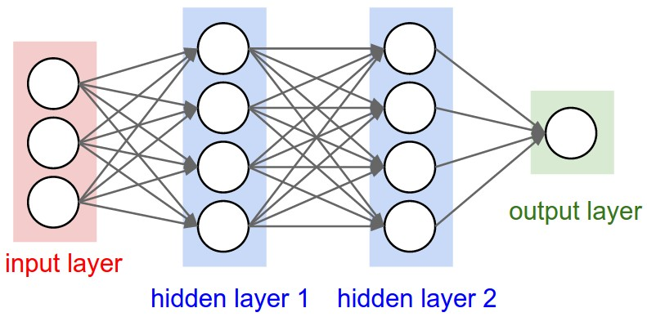
Structure of Deep Network
output
Components of Deep network
One input layer with a set of nodes that take the feature values for a sample
# nodes in this layer = dimension of the data = # features
One output layer with a set of nodes, that gives the class labels
# nodes in this layer = # class label in the training data
Multiple hidden layers, each layer contains a set of nodes
Higher the number of hidden layers, deeper the network

Slide 5
Ingredients of a Deep Network

Slide 6

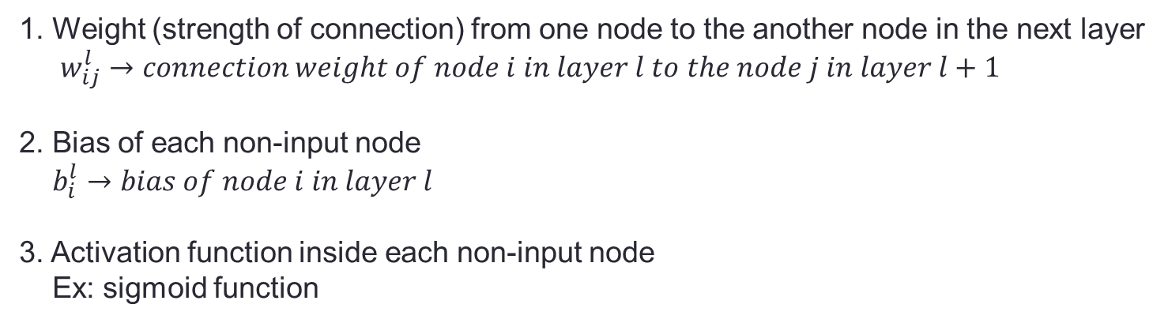
Ingredients of a Deep Network
Things you need to have in order to describe a deep network:
1. Weight (strength of connection) from one node to the another node in the next layer
$w_{ij}^{l}→connection weight of node i in layer l to the node j in layer l+1$
2. Bias of each non-input node
$b_{i}^{l}→bias of node i in layer l$
3. Activation function inside each non-input node
Ex: sigmoid function

Slide 7
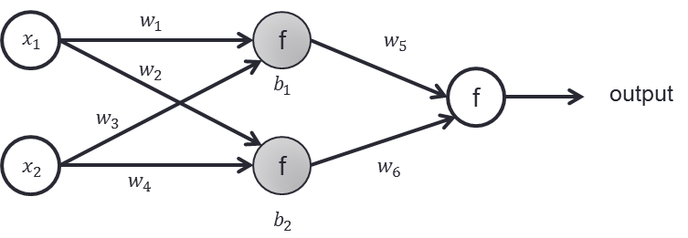
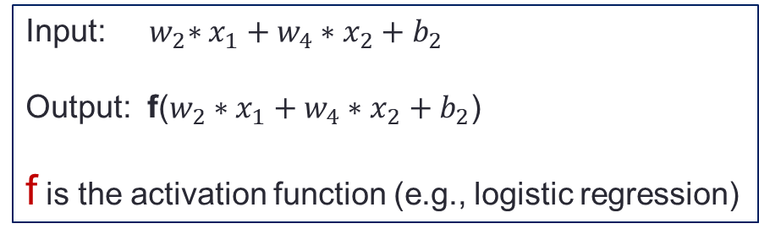
Ingredients of a Deep Network
What a non-input node of the network does?
Each node takes inputs from nodes from previous layer,
linearly combines them,
and then passes through the activation function
Input: ${ w}_{2}∗x_{1}+w_{4}∗x_{2}+b_{2}$
Output: f($w_{2}∗x_{1}+w_{4}∗x_{2}+b_{2}$)
f is the activation function (e.g., logistic regression)

Slide 8
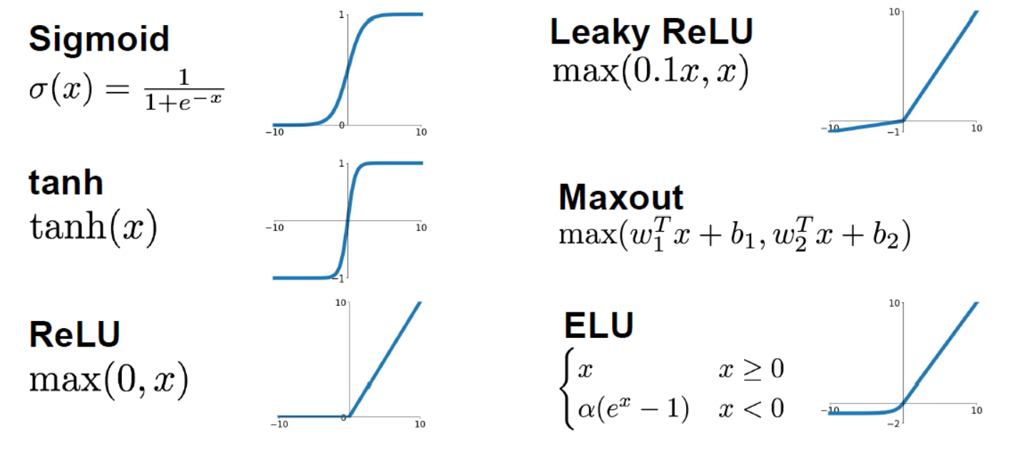
Activation Function

Slide 9
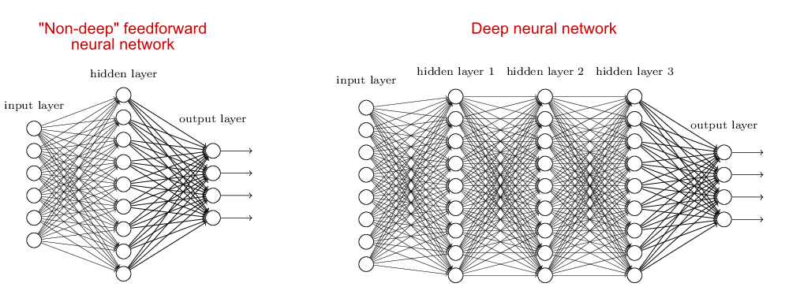
Deep vs. Shallow Network
What is the # features of the data the deep network trying to model?
How many class labels are there in that data?

Slide 10
Training Deep Network

Slide 11
Computing Gradient Backpropagation Algorithm

Slide 12
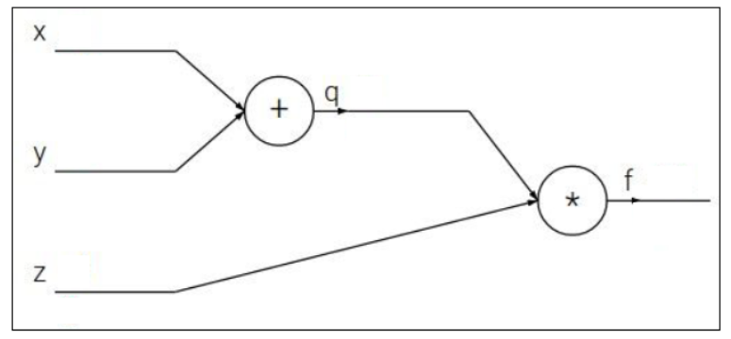
Backpropagation on Simple Graph
f(x,y,z) = (x+y)z

Slide 13
Backpropagation on Simple Graph
f(x,y,z) = (x+y)z

Slide 14
Backpropagation on Simple Graph
f(x,y,z) = (x+y)z

Slide 15
Backpropagation on Simple Graph
f(x,y,z) = (x+y)z

Slide 16
Backpropagation on Simple Graph
f(x,y,z) = (x+y)z

Slide 17
Backpropagation on Simple Deep Network

Slide 18









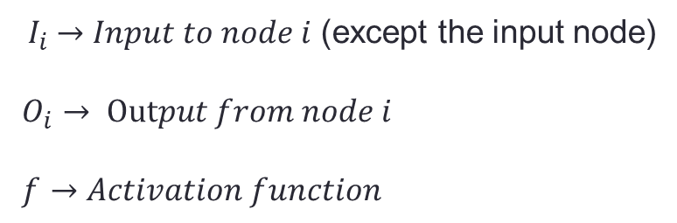




Training Neural Network
Let us start with the simplest network:
One feature, 2 class, 2 hidden nodes
$$b_{1}$$
$$b_{2}$$
$$b_{3}$$
$$w_{1}$$
$$w_{2}$$
$$w_{3}$$
x
1
2
3
$O_{3}$ (output)
$$I_{1}=w_{1}∗x+b_{1}$$
$$I_{2}=w_{2}∗{ f(I}_{1})+b_{2}$$
$$I_{3}=w_{3}∗f(I_{2})+b_{3}$$
$$O_{1}=f(I_{1})$$
$$O_{2}=f(I_{2})$$
$$O_{3}=f(I_{3})$$
${ I}_{i} →Input to node i$ (except the input node)
$O_{i}$ $→$ $Output from node i$
$f→Activation function$

Slide 19









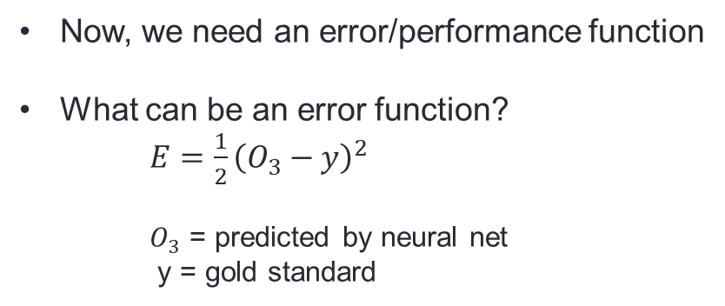




Training Neural Network
$$b_{1}$$
$$b_{2}$$
$$b_{3}$$
$$w_{1}$$
$$w_{2}$$
$$w_{3}$$
x
1
2
3
$O_{3}$ (output)
$$I_{1}=w_{1}∗x+b_{1}$$
$$I_{2}=w_{2}∗{ f(I}_{1})+b_{2}$$
$$I_{3}=w_{3}∗f(I_{2})+b_{3}$$
$$O_{1}=f(I_{1})$$
$$O_{2}=f(I_{2})$$
$$O_{3}=f(I_{3})$$
Now, we need an error/performance function
What can be an error function?
$E=\frac{1}{2}{\left(O_{3}−y\right)}^{2}$
$O_{3}$ = predicted by neural net
y = gold standard

Slide 20





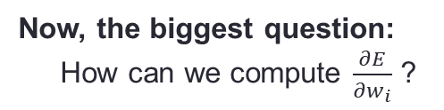

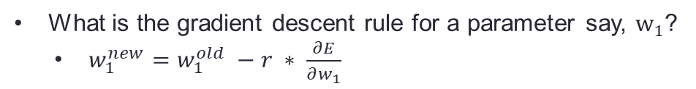







Training Neural Network
$$b_{1}$$
$$b_{2}$$
$$b_{3}$$
$$w_{1}$$
$$w_{2}$$
$$w_{3}$$
x
1
2
3
$O_{3}$ (output)
$$I_{1}=w_{1}∗x+b_{1}$$
$$I_{2}=w_{2}∗{ f(I}_{1})+b_{2}$$
$$I_{3}=w_{3}∗f(I_{2})+b_{3}$$
$$O_{1}=f(I_{1})$$
$$O_{2}=f(I_{2})$$
$$O_{3}=f(I_{3})$$
Error/performance function: $E=\frac{1}{2}{\left(O_{3}−y\right)}^{2}$
How can we find good values of parameters?
Answer: By gradient descent
What is the gradient descent rule for a parameter say, $w_{1}$?
$w_{1}^{new}=w_{1}^{old} −r ∗ \frac{∂E}{∂w_{1}}$
Now, the biggest question:
How can we compute $\frac{∂E}{∂w_{i}}$ ?

Slide 21



































Training Neural Network: Computing Gradients
$$b_{1}$$
$$b_{2}$$
$$b_{3}$$
$$w_{1}$$
$$w_{2}$$
$$w_{3}$$
x
1
2
3
$O_{3}$ (output)
$$I_{1}=w_{1}∗x+b_{1}$$
$$I_{2}=w_{2}∗{ f(I}_{1})+b_{2}$$
$$I_{3}=w_{3}∗f(I_{2})+b_{3}$$
$$O_{1}=f(I_{1})$$
$$O_{2}=f(I_{2})$$
$$O_{3}=f(I_{3})$$
Error/performance function: $E=\frac{1}{2}{\left(O_{3}−y\right)}^{2}$
Let us compute gradients:
$\frac{∂E}{∂w_{3}}$ =
$\frac{∂E}{∂O_{3}}$
$\frac{∂O_{3}}{∂I_{3}}$
$\frac{∂I_{3}}{∂w_{3}}$
$$×$$
$$×$$
$\frac{∂E}{∂w_{2}}$ =
$\frac{∂E}{∂O_{3}}$
$\frac{∂O_{3}}{∂I_{3}}$
$\frac{∂I_{3}}{∂O_{2}}$
$\frac{∂O_{2}}{∂I_{2}}$
$\frac{∂I_{2}}{∂w_{2}}$
The chain rule of derivative
$$×$$
$$×$$
$$×$$
$$×$$
$\frac{∂E}{∂w_{1}}$ =
$\frac{∂E}{∂O_{3}}$
$\frac{∂O_{3}}{∂I_{3}}$
$\frac{∂I_{3}}{∂O_{2}}$
$\frac{∂O_{2}}{∂I_{2}}$
$\frac{∂I_{2}}{∂O_{1}}$
$\frac{∂O_{1}}{∂I_{1}}$
$\frac{∂I_{1}}{∂w_{1}}$
$$×$$
$$×$$
$$×$$
$$×$$
$$×$$
$$×$$

Slide 22














































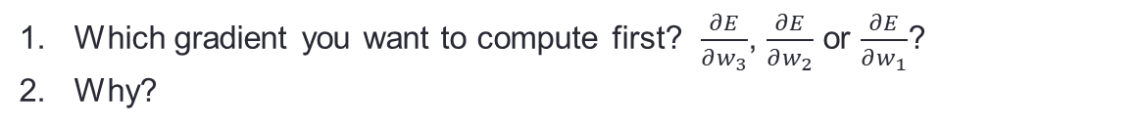
Training Neural Network: Computing Gradients
$$b_{1}$$
$$b_{2}$$
$$b_{3}$$
$$w_{1}$$
$$w_{2}$$
$$w_{3}$$
x
1
2
3
$O_{3}$ (output)
$$I_{1}=w_{1}∗x+b_{1}$$
$$I_{2}=w_{2}∗{ f(I}_{1})+b_{2}$$
$$I_{3}=w_{3}∗f(I_{2})+b_{3}$$
$$O_{1}=f(I_{1})$$
$$O_{2}=f(I_{2})$$
$$O_{3}=f(I_{3})$$
Error/performance function: $E=\frac{1}{2}{\left(O_{3}−y\right)}^{2}$
gradients: the common parts
$\frac{∂E}{∂w_{3}}$ =
$\frac{∂E}{∂O_{3}}$
$\frac{∂O_{3}}{∂I_{3}}$
$\frac{∂I_{3}}{∂w_{3}}$
$\frac{∂E}{∂w_{2}}$ =
$\frac{∂E}{∂O_{3}}$
$\frac{∂O_{3}}{∂I_{3}}$
$\frac{∂I_{3}}{∂O_{2}}$
$\frac{∂O_{2}}{∂I_{2}}$
$\frac{∂I_{2}}{∂w_{2}}$
$$×$$
$$×$$
$$×$$
$$×$$
$$×$$
$$×$$
$\frac{∂E}{∂w_{2}}$ =
$\frac{∂E}{∂O_{3}}$
$\frac{∂O_{3}}{∂I_{3}}$
$\frac{∂I_{3}}{∂O_{2}}$
$\frac{∂O_{2}}{∂I_{2}}$
$\frac{∂I_{2}}{∂w_{2}}$
$\frac{∂E}{∂w_{1}}$ =
$\frac{∂E}{∂O_{3}}$
$\frac{∂O_{3}}{∂I_{3}}$
$\frac{∂I_{3}}{∂O_{2}}$
$\frac{∂O_{2}}{∂I_{2}}$
$\frac{∂I_{2}}{∂O_{1}}$
$\frac{∂O_{1}}{∂I_{1}}$
$\frac{∂I_{1}}{∂w_{1}}$
$$×$$
$$×$$
$$×$$
$$×$$
$$×$$
$$×$$
$$×$$
$$×$$
$$×$$
$$×$$
Which gradient you want to compute first? $\frac{∂E}{∂w_{3}}$, $\frac{∂E}{∂w_{2}}$ or $\frac{∂E}{∂w_{1}}$?
Why?
This method is known as backpropagation

